Slide 1
UNIVERSITY COLLEGE OF ENGINEERING NAGERCOIL
(Anna University Constituent College)
AUTOMATING THE ACTIVITES
OF UCEN OFFICE USING CLOUD COMPUTING
Presented By,
Aakif Muhsin J,
Aswin Raja A,
Vibunesh A
Guided by,
Dr.J.Banumathi AP/IT

Slide 2
TABLE OF CONTENT
OBJECTIVE
ABSTRACT
SCOPE
EXISTING SYSTEM
LIMITATIONS OF EXISTING SYSTEM
PROPOSED SYSTEM
INTRODUCTION OF PROJECT
SYSTEM ARCHITECTURE
DATA FLOW DIAGRAM
USE CASE DIAGRAM

Slide 3
OBJECTIVE
To reduce the time spent on manual work and human error in managing data at college office.
To improve the process of student data handling .
Enhance the students to view their academic profile.

Slide 4
ABSTRACT
Most of the student data managing works in college office are done manually or using the Microsoft excel. Due to manual entry of data the possibility of human error in data manipulation is more. To avoid, and also to improve the process of handling the data, a web application was develop using cloud computing technology. This web application will reduce the manual work related with student(like Scholarship Filtration, Bonafide certificate generation, Make aware about the student profile)one by the staffs in the college office.

Slide 5
SCOPE
It helps the admin to enhance and keep, manage and control the entire data of the students in our institution.
It helps to access the data easily.

Slide 6
EXISTING SYSTEM
The activities such as student data filtration base on the eligibility for different scholarship schemes and student profile management are done manually or stored in the excel files.
The students have to approach their respective faculty members for knowing their internal marks and attendance .

Slide 7
LIMITATIONS OF EXISTING SYSTEM
Manual work are done.
Data is stored in the form of documents or excel files .
Search for a particular student’s profile is very hard.
There is no backup for data retrieval.

Slide 8
PROPOSED SYSTEM
In the proposed system , activities such as student data that filtrated by the student regarding scholarship schemes and student profile should be managed are done using cloud computing with a user-friendly interface.

Slide 9
INTRODUCTION TO PROJECT
Separate login credentials were provided to the office management, staffs and students.
The office management can able to access, modify all the student’s data and able to filter the data based on certain eligibility criteria.
The staffs can able to update the students internal marks and can able to view the full detail of the student by entering the register number.
Students can view their respective profiles including internal marks and attendance.

Slide 10
MODULES
SCHOLARSHIP MANAGEMENT
STOCK MANAGEMENT
STUDENT PROFILE MANAGEMENT
BONAFIDE GENERATION

Slide 11
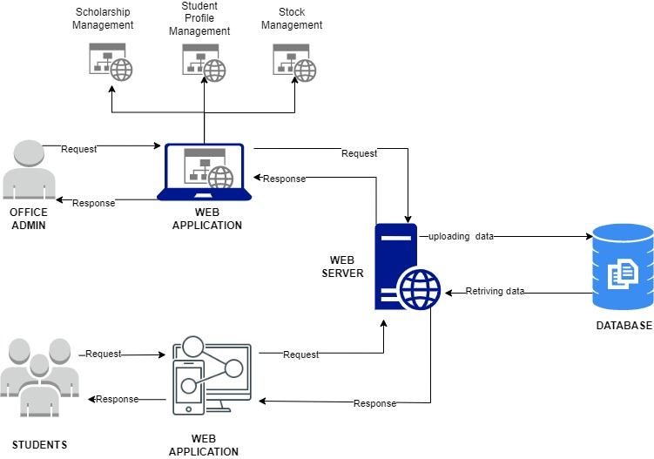
SYSTEM ARCHITECTURE

Slide 12
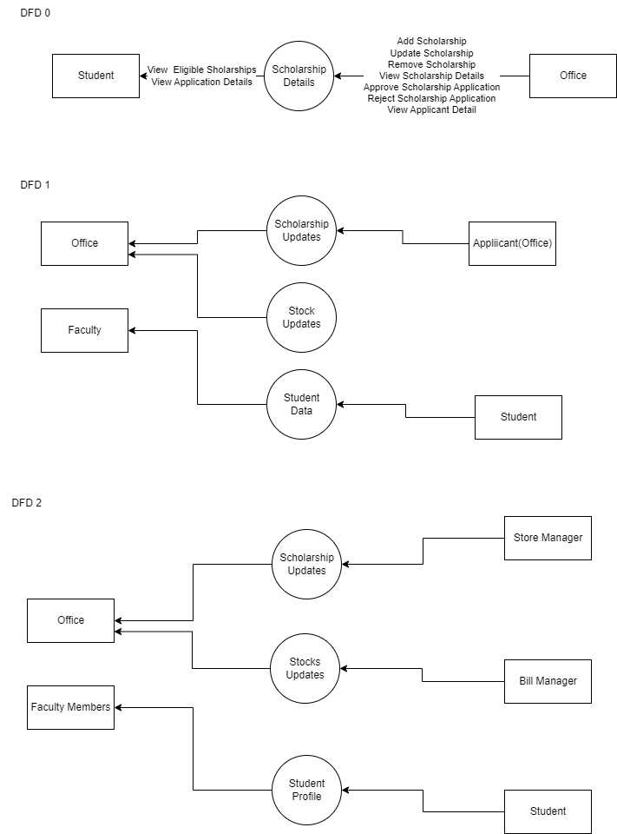
DFD-0

Slide 13
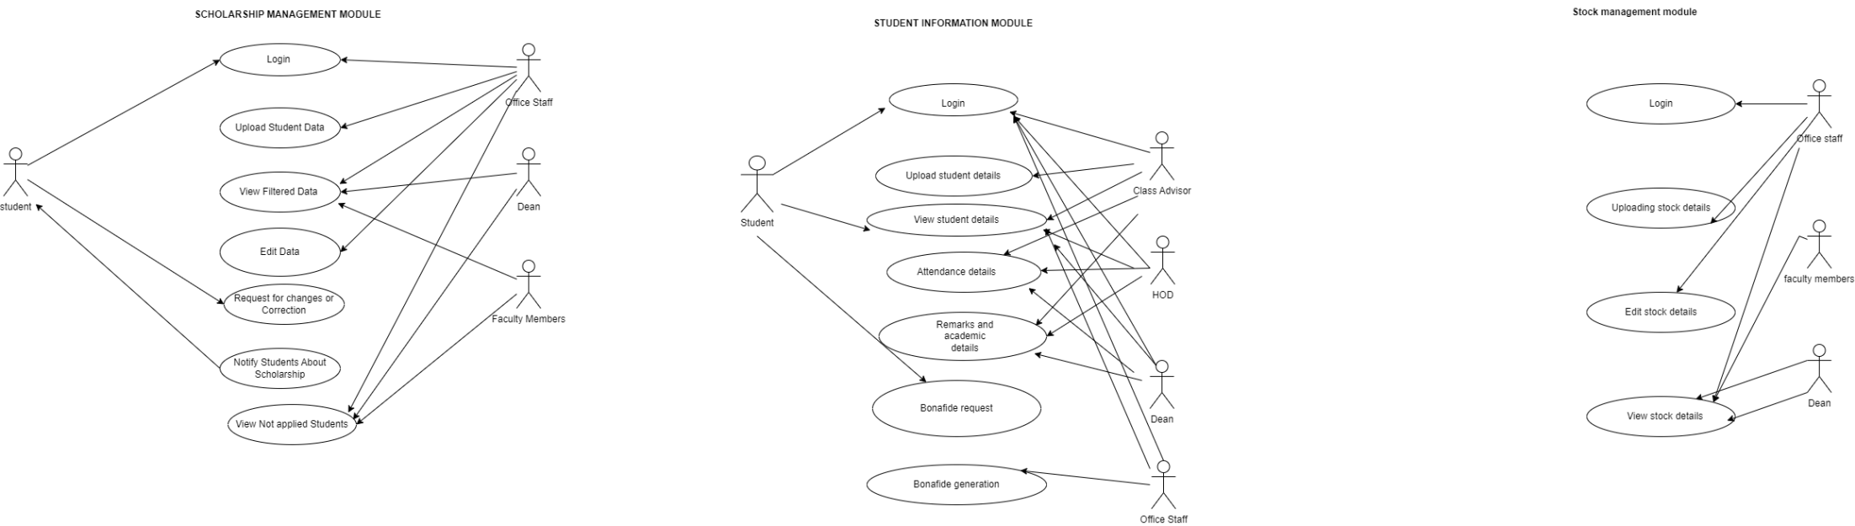
USE CASE DIAGRAM-1

Slide 14
USE CASE DIAGRAM-2

Slide 15
USE CASE DIAGRAM-3

Slide 16


